Slide 1



Innovative Approaches: Transforming Access to Care in the District of Columbia

Slide 2


Behavioral Health in the District of Columbia
More than half of Americans report that COVID-19 has had a negative impact on their mental health. In February 2021, 43.7% of adults in Washington, DC reported symptoms of anxiety or depression.
25.7% were unable to get needed counseling or therapy
In Washington, DC, 125,000 adults have a serious mental illness.
1 in 20 U.S. adults experience serious mental illness each year
1 in 6 U.S. youth aged 6–17 experience a mental health disorder each year.
3,000 Washingtonians age 12–17 have depression.

Slide 3


The reality.
Patients with behavioral needs...
Wait 3X
as long for clinically appropriate care in hospital emergency departments than patients with other care needs.

Slide 4
The reality.
Patients with behavioral needs...
Spend 19.9
Million Hours
in hospital emergency departments for a transfer to clinically appropriate care.

Slide 5
XFERALL is a matchmaker,
data gold mine and cost saver all in one.
Created by clinicians for clinicians, the XFERALL mobile/web app automates the process of transferring acute and behavioral patients to find the right fit, gather insightful data and save costs.
FASTER
EASIER
SMARTER
Put inefficient phone calls and faxes between receiving facilities to bed.
Rich data and
real-time document sharing for transfer process improvements.
Save lives, build relationships and free up resources.

Slide 6




Xferall brings providers together to find the right care center for patients
SENDERS
Receivers
Local Mental Health Authorities
EMS, Law Enforcement
Crisis Stabilization Units
Hospitals
Mobile Crisis Teams
State Psychiatric Hospitals
Community Providers
All Psychiatric Beds/Units
School Districts
Specialty Hospitals & IMDs

Slide 7
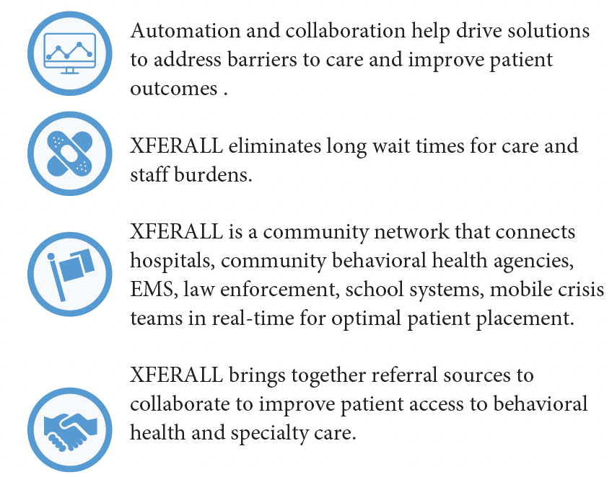
XFERALL Real-Time Referral and Placement Network
Collaborative Communication Tool
The Problem
Patients with acute psychiatric conditions are waiting in hospital emergency departments for hours and sometimes days before being placed in appropriate treatment, whether inpatient, outpatient, residential, or crisis stabilization.
The Solution
XFERALL reduces patient transfer times consistently by 80% to 90% across the network, creates efficiencies for staff to allow more time to focus on patient care, and is aligned with the National Guidelines for Crisis Care and SAMHSA best practices.

Slide 8

XFERALL Benefits Our Partners
XFERALL will eliminates the significant costs and time associated with the complex treatment referral process and provides real-time communication for placement.
XFERALL can work across state lines if patient placement requires expanded treatment options – our platform geolocates based on patient clinical needs and demographics.
XFERALL reduces patient transfer times consistently 80-90% across the network. Supports when appropriate diverting patients from ED to other care settings that have capacity to meet the clinical needs for the patients.
XFERALL aligns with the National Guidelines for Crisis Care and SAMHSA Best Practices. Supports 988 crisis expansion as a tool to coordinating care and referrals.
XFERALL is a community network that empowers hospitals, EMS, Law Enforcement, School Systems, Local Health Authorities, Mobile Crisis Teams and any other community referral sources working together to improve patient access to behavioral health and specialty care .
XFERALL provides exceptional ongoing services and support through our Client Success Team with an assigned Account Manager who will partner with your team to use data to drive improvements while supporting all users from the private and public/state sector in a market.
XFERALL trains and provides ongoing support to community referral sources at No Cost and partners with them to improve their outbound transfer requests processes.
Platform is EMTALA and HIPPA compliant-full security assessments are performed.

Slide 9



XFERALL is a win-win going out and coming in.
Sender-Referring Provider
RECEIVERS
Faster placement - Reduced workload - Better patient care
Dramatically reduce ED boarding time
                Easily identify bottlenecks delaying placement
Reduce harm events for patient & employees
Establish a transfer system or record
  Eliminate call logs and remain EMTALA compliant
Track transfer patterns
                Helps manage relationships with receiving institutions
Reduce referral workload
Ensure better patient care with 24-hour patient follow up

Slide 10


XFERALL is a win-win going out and coming in.
RECEIVERS-Accepting Provider
SENDERS
Faster intake - Stronger referrer relationships - Expanded reach & data tracking
Improve intake operations
  Reduce reliance on fax
  Eliminate wasteful ‘Old school’ tasks
Improve relationships with your current referrers
Access admissions from larger geographic region
Improve customer service
Employ data-driven intake operations to improve response times
Identify market needs for certain services or age groups

Slide 11

Continuous quality improvement for psychiatric boarding and risk mitigation
Best course of action to mitigate risk:
Best course of action to mitigate risk:
XFERALL efficiently helps ER departments reduce:
Quickly assess the patient
Determine appropriate level of care
Transition patient to appropriate specialized treatment
ED transfer times
Harm events to self or others
Elopements
Restraints and seclusion
AMA discharge without appropriate transition to care
Use of emergency psychiatric medication
Intervention of security/law enforcement

Slide 12

The solution.
XFERALL customers experience….
86
%
decreases patient transfer times by increasing efficiencies

Slide 13
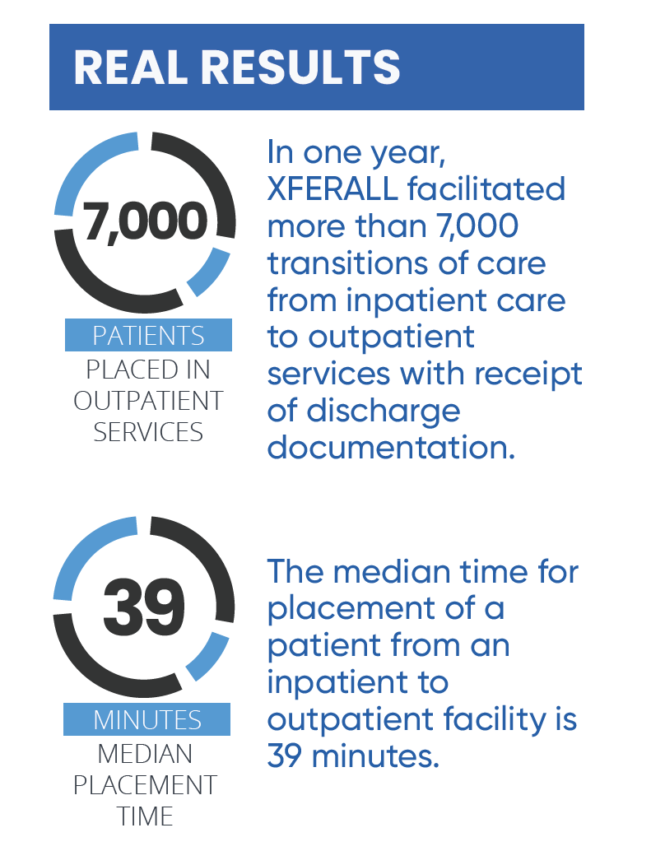
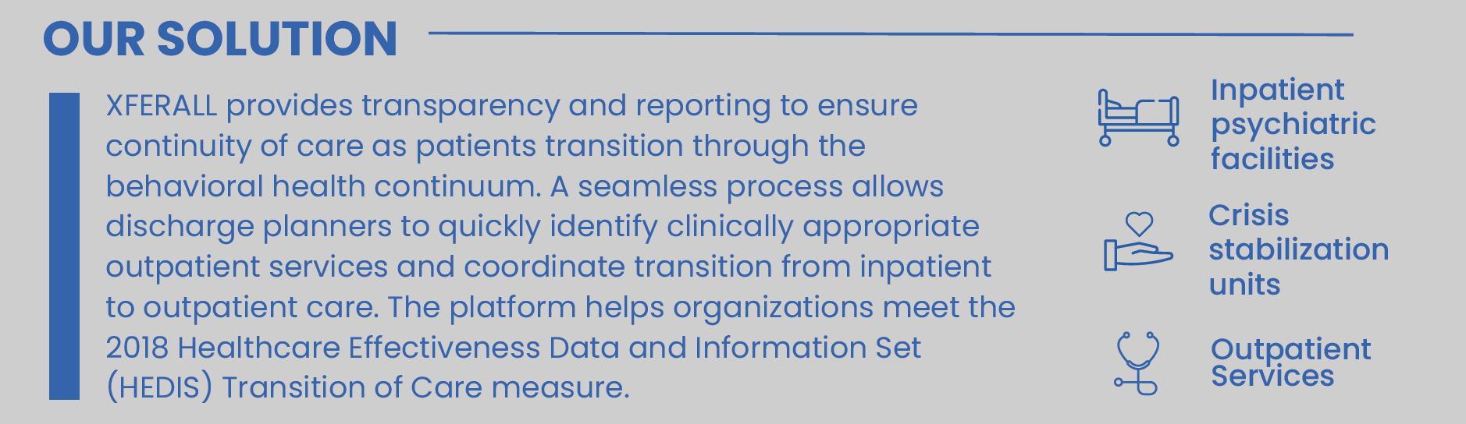
Ensuring Successful Transitions of Care
XFERALL Provides Solutions for Better Scheduling Along the Continuum of Care

Slide 14
Crisis Response Collaborative Communication
988
911
Existing Crisis Lines
Call Centers
Active Rescue
No Services Follow Up
Mobile Crisis Response
Crisis Receiving Center
Co-Response
ES/ ED
Call Center
CITAC, CSU, 23 Hours Obs, Walk-In/ Drop-off Centers
Community Mental Health Centers
Formal: EMS/ Mental Health
Informal: Law Enforcement/ Mental Health
Alternative Transportation
Pre-Screening/ Involuntary Psychiatric Transfer
XFERALL Patient Transfer & Placement Tool
Behavioral Health Care Acute and Out-Patient Placement Along The Continuum of Care
Crisis Stabilization Unit
Inpatient Hospitalization
Residential Treatment
Day Treatment
Outpatient Treatment
Telehealth Treatment

Slide 15


XFERALL Aligns with SAMHSA’s National Guidelines for Crisis Care
The platform key elements incorporate Substance Abuse and Mental Health Services Administration (SAMHSA) recommendations by:
Reduces in-patient psychiatric hospital bed overuse; supports diversion to community-based sites when appropriate
Eliminates long psychiatric-behavioral health boarding times in emergency departments
Provides GPS-enabled technology to allow collaboration with partners like EMS, law enforcement and crisis mobile teams to be more efficient in dispatching care to those in need
Utilizes real-time data to allow requests to clinically matched facilities and location for optimal placement
Supports quality and system review through data analytics

Slide 16
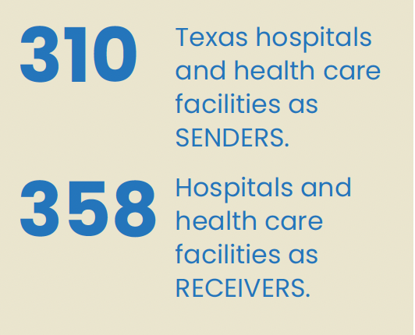
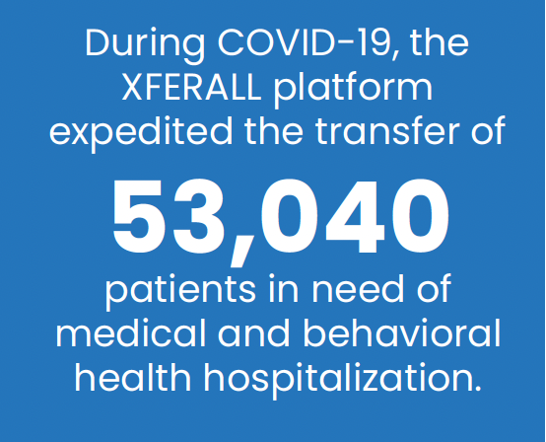
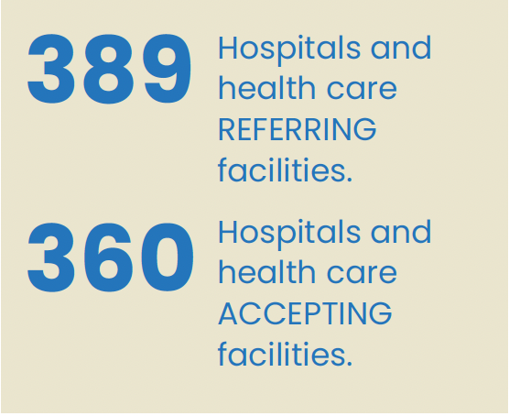
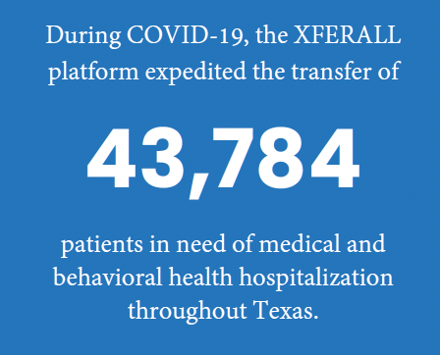
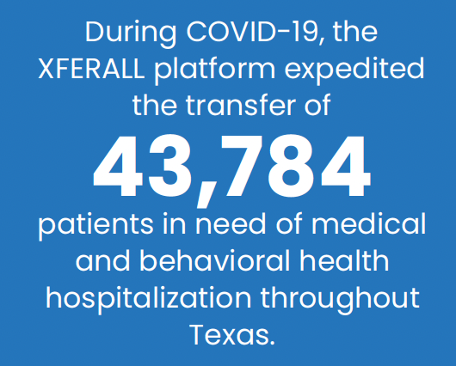
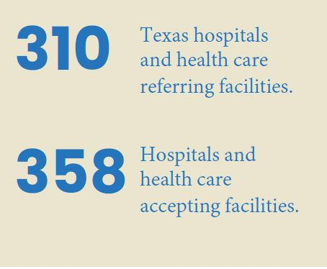
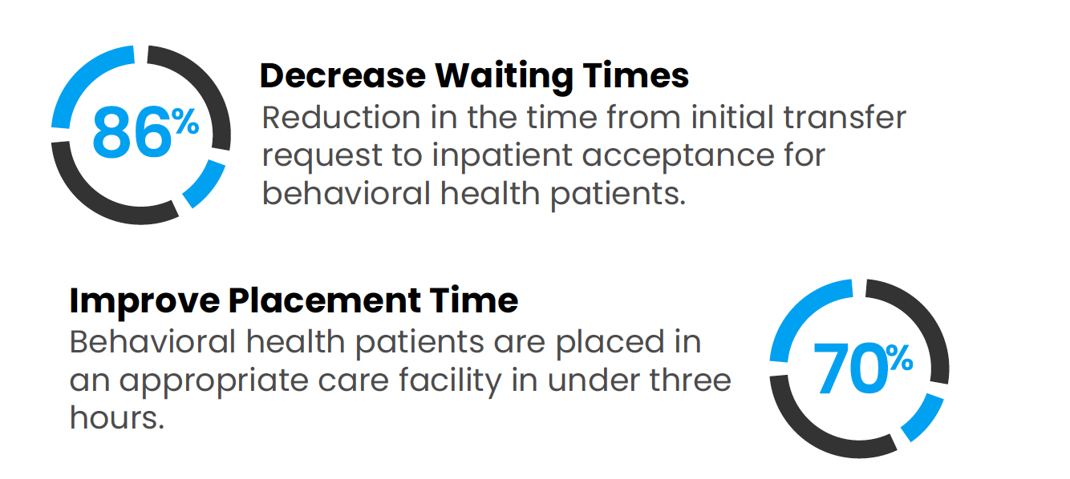
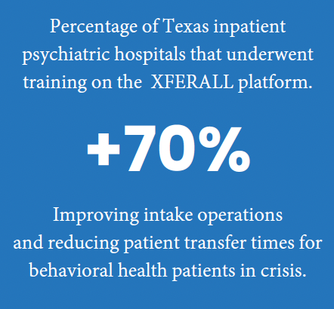
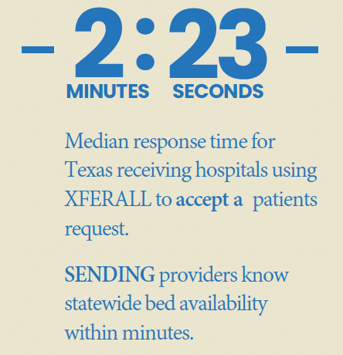
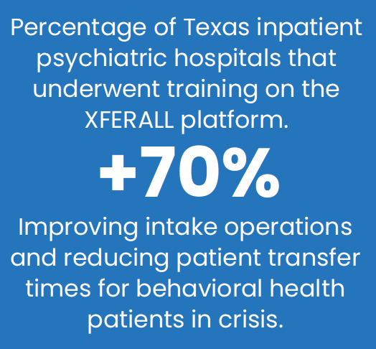
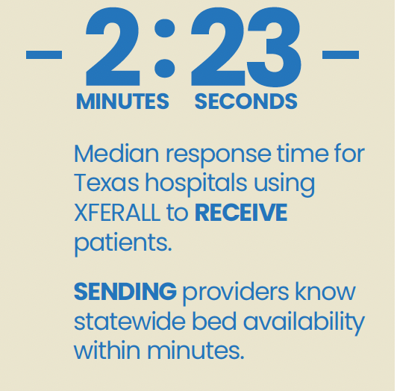
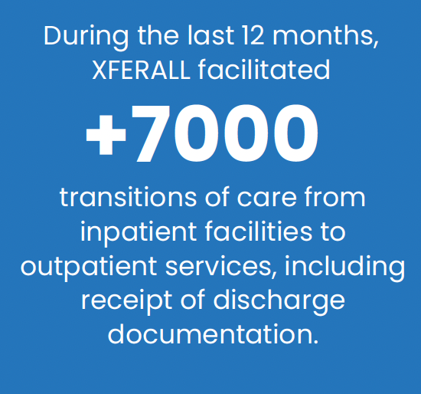
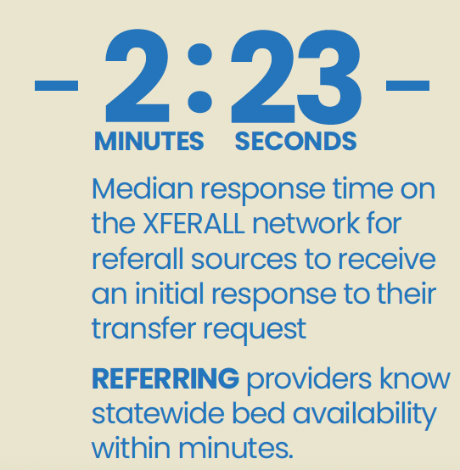
Faster Placement. Improved Outcomes. Reduced Staff Burden.
Case Study
The Results Speak for Themselves

Slide 17
Case in point. Every moment is critical.
Mobile crisis team and private psychiatric hospital reduced behavioral health transfer times for entire region
Rural region of Texas covering 21 counties and 21,580 miles implemented XFERALL in a joint strategy between community mobile crisis team, private psychiatric hospital, critical access hospitals, law enforcement and jails
Region historically struggled with significant delays and extended wait times impacting entire region
XFERALL data analytics exposed system-wide bottle necks and opportunities for workflow improvements
Outcome – 95 Percent Decrease in Behavioral Health Patient Placement Times

Slide 18
Behavioral Health Patient Transfer Case Study
An urban 17 hospital health system in Houston, TX implemented the XFERALL app to coordinate behavioral health outbound transfers in 2019.
1,225 hours saved monthly
3,500,000+ saved annually
*Based on 188 transfers per month. Hours reduced are from request to acceptance $250/hr. for BH boarding (NH Data)

Slide 19
“I can look at the XFERALL dashboard and see that one facility responded in eight seconds and the other hospital in two seconds. It’s literally that quick, which has helped us save tons of time and money in staff overtime and efficiencies.”
Brittany Waymack, Denton MHMR Administrator, Mobile Crisis Team

Slide 20
Less wait time, better care.
“XFERALL has helped us provide better care for patients. Using this system, we’ve cut our ER wait time dramatically with most patients getting placed in just a couple hours. And, the 24-hour follow-up helps us meet our goal of excellent patient care outcomes.”
Veronica Armendariz | Denton MHMR
Program Manager, Mobile Crisis Team

Slide 21
Moving faster for behavioral health needs
“We think XFERALL is great and prefer to use it. We have 4 nurses at night and when we have a one-on-one BH patient it really hits our team hard. XFERALL helps us get the patients moved to a higher level of care much faster and gives us back our ED beds.”
Ochiltree General Hospital, Perryton, Texas

Slide 22

Thank You
Q&A
Shana Palmieri
CCO / Co-Founder
shana.palmieri@XFERALL.com
682.465.8524

